Slide 1
Static Range Queries

Slide 2
Agenda
Frequency Array
Prefix and Suffix Arrays

Slide 3
Static Range Queries
Static Range Queries means that you have some elements and you are required to perform some queries (questions) about some range of theses elements.
For example, you are given an array of size 10, and the query is to get the sum of elements from index 3 to index 7.
For that type of problems, it will be helpful to learn some techniques: Frequency Array, Prefix and Suffix Arrays, and some additional trick you might need.

Slide 4
Frequency Array
Frequency Array means to store the number of occurrences (frequency) of each element you have
This will save much time (complexity) by just access the frequency in O(1) instead of iterating over the whole elements each time O(n)
All you have to do is just to reserve an array of size equals to the domain (the maximum value) of your elements.

Slide 5
Example
const int MAX=1e6;
int main(){
int freq[MAX+1]={0};
int n, x;
cin>>n;
while(n--){
cin>>x;
Freq[x]++;
}
for(int num=1; num<=MAX; num++)
if(freq[num]>0 && freq[num]%2==0)
cout<<num<<' ';
return 0;
}
You are given n integers numbers, and you are asked to print the elements that appears even number of times.
(1<= n <= 10^5)
(1 <= number<=10^6)

Slide 6
Frequency Map
But what if ?
the domain is so large (1<=number<=10^12)
You have negative integers (still frequency Array will work with shifting trick)
You have floate numbers
Your elements are not even numbers (ex: strings)
You can use Frequency Map instead of Frequency Array

Slide 7
Example
int main(){
unordered_map<string,int>freq;
int n;
cin>>n;
while(n--){
string s;
cin>>s;
freq[s]++;
}
int mx=0;
string ans="";
for(auto& p : freq)
if(p.second > mx) mx=p.second, ans=p.first;
cout<<ans<<'\n';
}
You are given n strings, and you are asked to print the most occuring string.
(1<= n <= 10^4)
(1 <= |string|<=100)

Slide 8
Prefix and Suffix Arrays
Prefix Array means an array holding accumulated info from the beginning of another array till each index. You can accumulate any info like sum, multiplication, minimum, maximum, xor, ..etc.
Array : 2 1 0 3 5 6
Prefix Sum Array: 2 3 3 6 11 17
Suffix Array means an array holding accumulated info from the end of another array till each index. You can accumulate any info like sum, multiplication, minimum, maximum, xor, ..etc.
Array : 2 1 0 3 5 6
Suffix Sum Array: 17 15 14 14 11 6

Slide 9
Prefix Array
const int N=1e5;
int main(){
int arr[N];
int suffixSum[N], suffixMin[N];
int n;
cin>>n;
for(int i=0; i<n; i++) cin>>arr[i];
prefixSum[0]=prefixMin[0]=arr[0];
for(int i=1; i<n; i++){
prefixSum[i]=arr[i]+prefixSum[i-1];
prefixMin[i]=min(arr[i], prefixMin[i-1]);
}
return 0;
}

Slide 10
Suffix Array
const int N=1e5;
int main(){
int arr[N];
int suffixSum[N], suffixMin[N];
int n;
cin>>n;
for(int i=0; i<n; i++) cin>>arr[i];
suffixSum[n-1]=suffixMin[n-1]=arr[n-1];
for(int i=n-2; i>=0; i--){
suffixSum[i]=arr[i]+suffixMin[i+1];
suffixMin[i]=min(arr[i], suffixMin[i+1]);
}
return 0;
}

Slide 11
Range Info with Inverse Operation
Using prefix or suffix arrays we can get info about range (subsegment) of elements in O(1) instead of O(n)
This is doable with the operations that have valid inverse operations like
sum (addition) and its inverse subtraction
multiplication and its inverse division,
but not minimum or maximum

Slide 12
Range Sum using Prefix Sum
int main(){
int arr[N+1]={0}, prefixSum[N+1];
int n;
cin>>n;
for(int i=1; i<=n; i++) cin>>arr[i];
for(int i=1; i<=n; i++) prefixSum[i]=arr[i]+prefixSum[i-1];
int l,r;
cin>>l>>r; // one-indexed
cout<< prefixSum[r] - prefixSum[l-1]<<'\n';
}

Slide 13
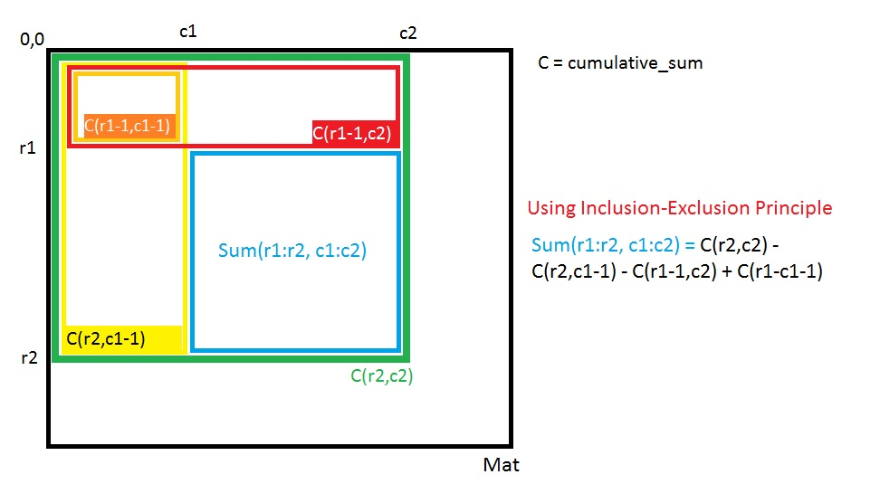
2D-Rectangle Sum using Prefix Sum
https://ideone.com/egVGVk

Slide 14
To Solve
Degree of an Array
Find Pivot Index
Majority Element
Subarray Sum Equals K

